Slide 1
Phase 4
PROTOTYPE
Notes:
Review the previous weeks assignment for 20 – 30 mins before beginning the presentation. This week is to make the students learn about physical and functional decomposition

Slide 2
PRODUCT ARCHITECTURE
Functional Decomposition
Physical Decomposition
What?

Slide 3
FUNCTIONAL DECOMPOSITION
Functional Flow Analysis:
Processes
Required Parts
Notes:
Functional Decomposition means identifying what the new product must be able to function..
Functional Flow Analysis is the analysis of a series of tasks (to be performed by the user) is to be made and written down.
Process – Involves all the functions that the product must do to help the user accomplish the task.
Required Parts are to be identified based on your concept and the processes.

Slide 4
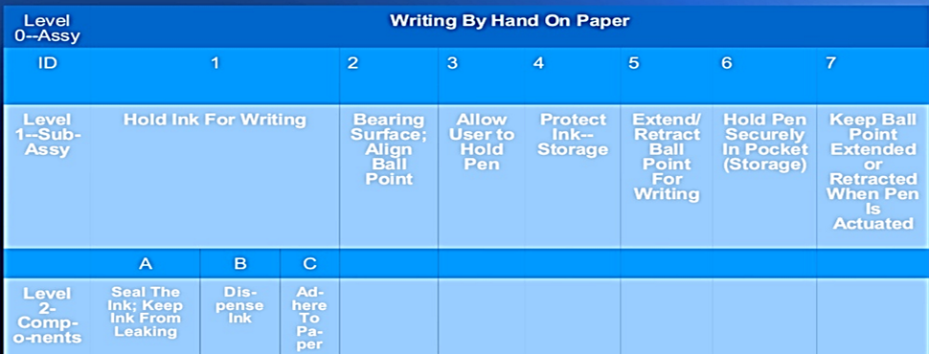

Slide 5
PHYSICAL DECOMPOSITION
Identify:
Required Parts
Specifications
Processing
Assembly
Notes:
Required Parts are the ones identified during Functional Decomposition
Specifications and Dimensions are the units of the physical part – Material, Shape, Size, Colour, Technical Details, etc.
Processing means any operation to be performed to obtain the part’s function – Cutting, Bending, Finishing, Shaping, Punching, etc.
Assembly means joining all the different parts together to make it a finished product, ready to be used for solving the pain / problem you have identified during the start of the course.

Slide 7
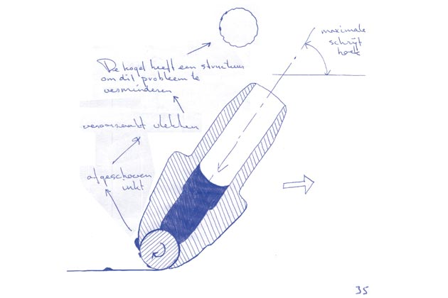
Explanatory Sketch
Notes:
As shown in the given example, All the team members are required to draw a sketch presenting all functional and physical details of the product through labelling.

Slide 8
Review
Functional Decomposition
Physical Decomposition
Notes:
Review the activities in the class.

Slide 9
Assignment 4 Marks: 3
Make a Power Point Presentation on your Product Architecture in the shared format.
Notes:
Share ‘PDS - Assignment - 4 – Product Architecture - Template.pptx’ to the WhatsApp group.

